Slide 1
User Industry Classification
PROJECTING ANALYTICAL VIEWS FOR ENERGY TRANSITION PRODUCTS TO DETERMINE PROPER CLASSIFICATION OF COMPANY INDUSTRY TO CORRECT ‘OTHER’ CATEGORY

Slide 2
Overview
Purpose
Data Wrangling
EDA
Preprocessing, Modelling, Results

Slide 3
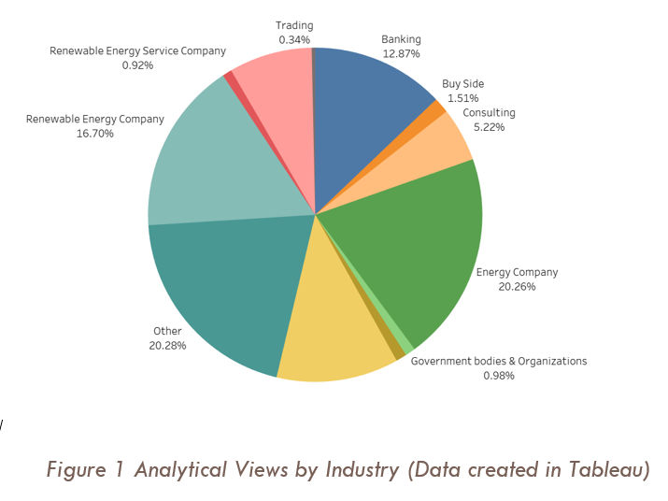
Purpose
Energy Transition has been a central topic in the news for the last 6 months and many companies are beginning to see the change in culture and policies and preparing for the position themselves properly. A certain energy data company would like to know how they can improve their data collection process and retroactively correct thousands of data points for companies. These data points classify a company’s industry as “other” rather than their actual industry. The goal of this project will be to use the company views to cluster the company in the proper industry type. This will allow for improved analytics and future targeting of company to solution products.

Slide 4
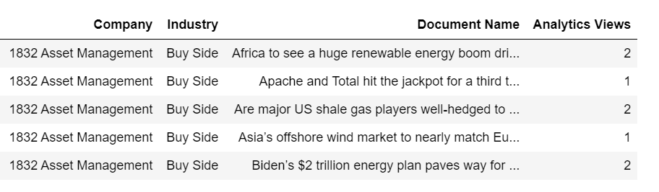
Data Wrangling
CSV File from User Activity database
Cleaned for erroneous document names
3 years of data

Slide 5
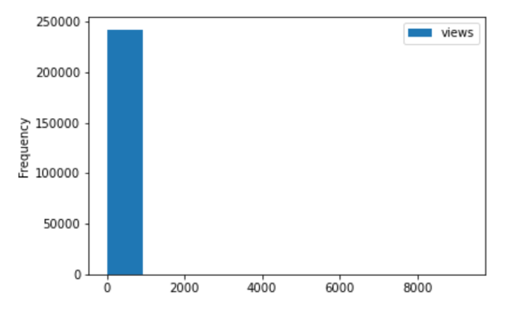
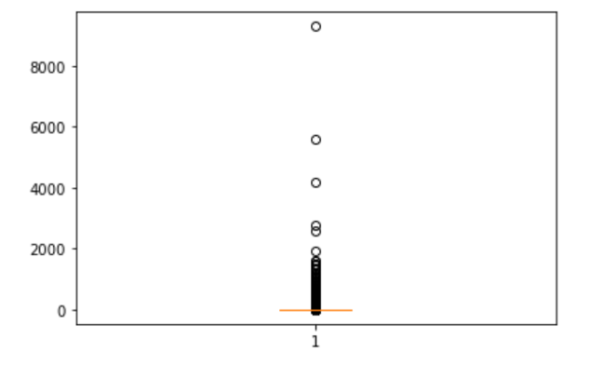
EDA
Highly right skewed distribution of analytical views
Extremely high outliers that are legitimate data points, so they were left in

Slide 6
Training, Modelling, Results
Training
Models
Data table was encoded
Random Forest and KNN were chosen for modelling
Random Forest model chosen with an 82% accuracy
Model | ACC
Random Forest | 0.82
KNN | 0.57

